Slide 1
Think for the Future Workshop:
Managing our customers
27 September 2018

Slide 2
Agenda
What is customer relationship management and why is it important to our business?
Our customers: what do they want/expect from a relationship? What are their “moments of truth”?
What would good CRM look like for us? – key principles, process & outcome metrics
LUNCH
Developing a ‘service blueprint’: What systems & processes do we need to put in place to deliver this? Who will do this across TFTF? Do we have the required skills?
How can we safely test some of these new ideas before full-scale roll out?
Next steps

Slide 3
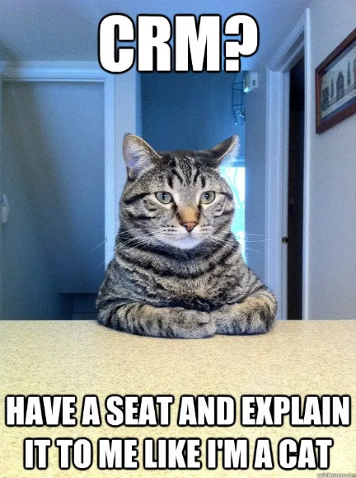
What do we mean by Customer Relationship Management?

Slide 4
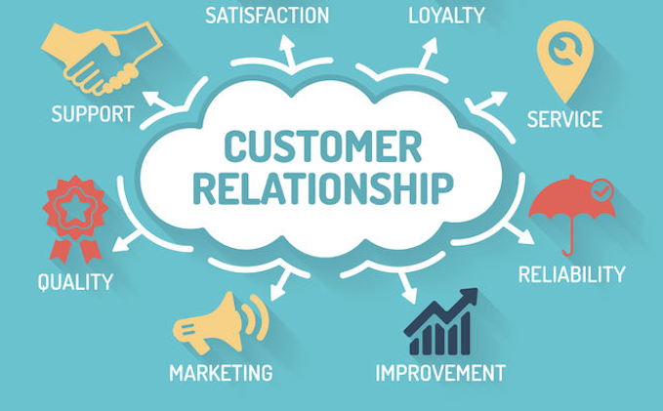
What do we mean by Customer Relationship Management?
A business strategy that aims to understand, anticipate and manage the needs of our current and potential customers
Comprehensive approach providing seamless integration of every area of our business that touches the customer (marketing, sales, delivery) and the integration of people, process & technology
Shifts the perspective from solely acquisition of new customers to retention & closer working with existing customers

Slide 5
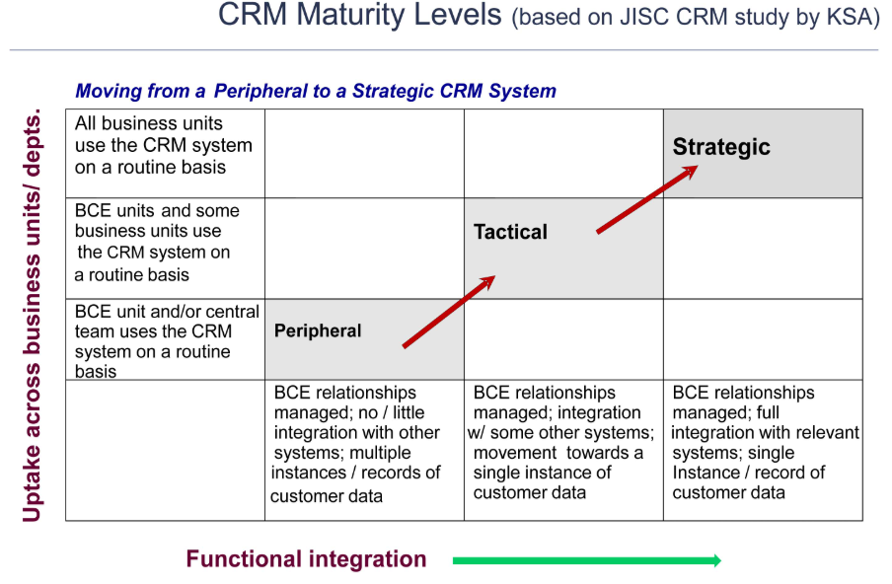
What is TFTF’s maturity in this?
Notes:
Peripheral
Isolated incidences of CRM usage
Limited approach to information sharing
CRM system mainly used to manage contacts
Some interoperability between systems but still a number of cultural issues in terms of a lack of a willingness for schools/departments to share info
Tactical
multiple incidences of CRM usage
Informs service delivery and improvement
Use of CRM system across a number of departments/business unites
Some integration with other institutional systems
Strategic
Institution-wide use of CRM across all business units
Informs strategic management of relationships
Fully integrated with other institutional systems.

Slide 6

Why does it matter to us?
Notes:
Prompts:
Repeat business / might provide opportunities for upselling providing foundation of trust has been established
Generate leads
Maintain good reputation – get testimonials / impact data
Get insight to develop our service offer
Allows us to deliver better service / easier operating relationship
Withstand cutbacks in client budgets
Reduce spend on marketing

Slide 7

What do our customers want?
What feedback have we had from customers?
What challenges are they facing we can help with?
What opportunities do they give us to make a good impression?
What’s been your own experience of good customer relations?
Notes:
Look at customer personas
Are all customers the same or do we have different types emerging?
Less a science more an art – but still useful to map out the customer journey to understand points you should be mindful of
Useful (what’s the hygiene factor) – Useable (what’s the experience of working with you) – Desirable (what’s the “wow” factor eg handwritten thank you, visit from the office puppy!)

Slide 8
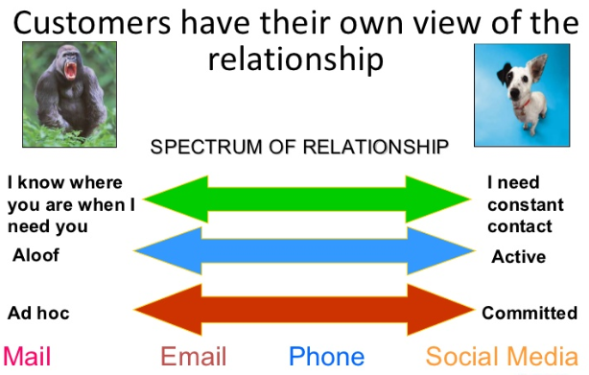
Are there different types of customers?
Notes:
It’s a 2-way relationship. You can also assess how attractive different customers along dimensions such as reliability/profitability, reputation, ease to work with, want to create a true partnership
Think about what’s the strength of your relationship at the moment – and where you’d like it to be

Slide 9

What do we want?
What are the key principles of how we want to interact with our customers?
How will we know we’re achieving this?
What outcomes do we expect to see as a result?
Notes:
How would other companies do this for their customers?
What are our competitors doing?
Overall, what are our key principles of how we work? Eg TFTF wants our customers to say that we:
are the go to person whenever they have a problem
Don’t stay in touch just to sell
Proactively seek feedback & act on it! (You’d rather do this before ppl leave).
Internally we know that we:
Spend 80% of your time with your top 20% of clients -> have a way to manage those that then don’t make the best use of your time
“Don’t feed the beast” – the CRM system is there to help you, not dictate your life!
We have good, easy to access information about each customer – stored in a handy place that captures core details we need
How will we measure process / outcomes?
Like ToC, you can apply the same idea of:
‘Input’ (eg leads generated, net promoter score, people reading/unsubscribing from your newsletter, # of monthly contacts) ->
‘Outcome’ (eg £ sales via referrals, retention rates) metrics to CRM KPIs

Slide 10
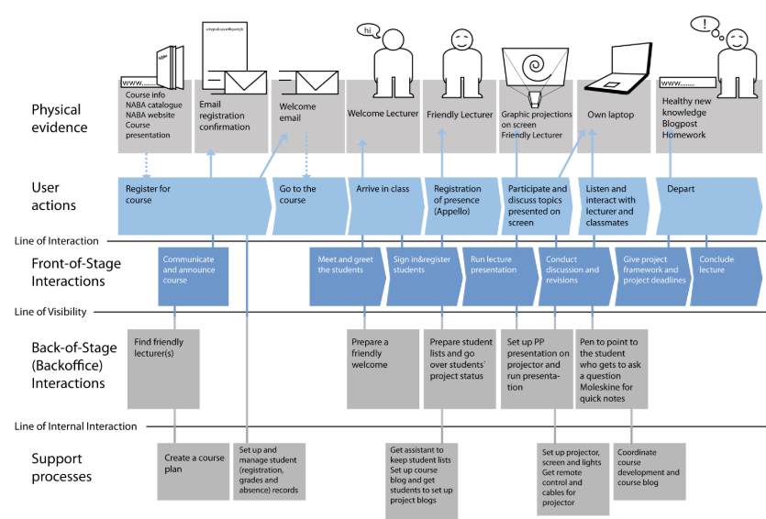
Building a service blueprint
Notes:
Go through the mapping exercise. May need to fill in more detail later.
At the end, stand back & think:
How do we compare to this vision? What are the gaps?

Slide 11
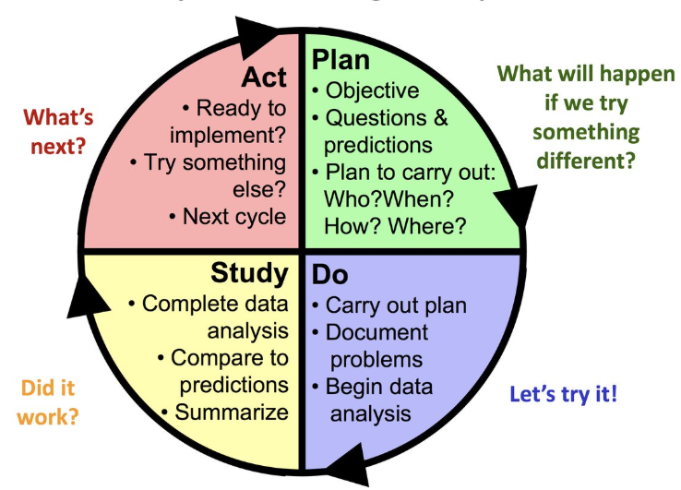
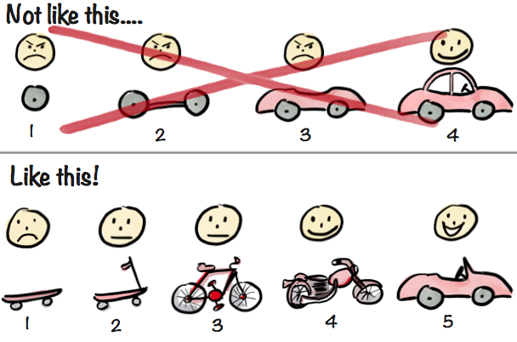
What will we test & learn?
Notes:
Do you have an understanding of:
Why you will proceed? What do you expect in terms of returns?
What are the barriers you’re likely to encounter? How will you overcome these?

Slide 12
Next steps
What actions are we committing to?
Who is going to lead on them? By when?
Who else do we need to involve?
What support do we need to deliver?

